Slide 1
UNIT-II Building Blocks of Language

Slide 2
Primitives Data Types
Data types represent the different values to be stored in the variable. In java, there are two types of data types:
Primitive data types
Non-primitive data types

Slide 3
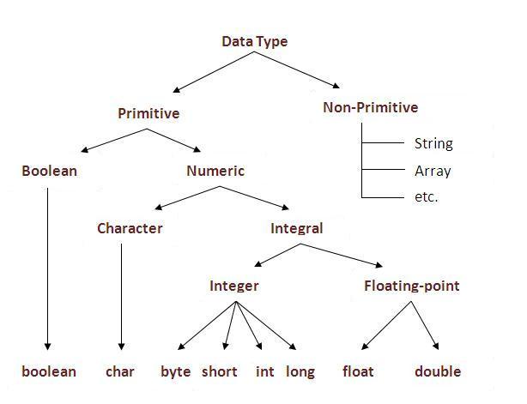

Slide 4
Type | Description | Default | Size | Example Literals
boolean | true or false | false | 1 bit | true, false
byte | twos complement integer | 0 | 8 bits | (none)
char | Unicode character | \u0000 | 16 bits | 'a', '\u0041', '\101', '\\', '\'', '\n', 'ß'
short | twos complement integer | 0 | 16 bits | (none)
int | twos complement integer | 0 | 32 bits | -2, -1, 0, 1, 2
long | twos complement integer | 0 | 64 bits | -2L, -1L, 0L, 1L, 2L
float | IEEE 754 floating point | 0.0 | 32 bits | 1.23e100f, -1.23e-100f, .3f, 3.14F
double | IEEE 754 floating point | 0.0 | 64 bits | 1.23456e300d, -1.23456e-300d, 1e1d

Slide 5
User Defined Data Type
User defined data types are those that user programmer defines. For example, classes, objects, strings, interfaces.
This is also called object or reference type.
Employee e1 = new Employee();

Slide 6
Derived Data Type
Derived data types are those which used to store multiple values of same type.
They are made by using any other data type for example, arrays.
int a[]=new int[5];
a[0]=10;
a[1]=20;
a[2]=70;
a[3]=40;
a[4]=50;

Slide 7
Identifiers and Literals
Literals means constant values like 1, 1234, -45, 3.14, “Hello”.
Ex: Boolean Literals, integer , character literals etc.
Ex: Char c=“a”;
Int x=10;
Boolean value=true;

Slide 8
Identifiers and Literals
In programming languages, identifiers are used for identification purpose. In Java an identifier can be a class name, method name, variable name or a label.
For example :
public static void main(String[] args)
Here, string, args, main are identifiers.

Slide 9
Rules for Identifiers
There are certain rules for defining a valid java identifiers. These rules must be followed, otherwise we get compile-time error. These rules are also valid for other languages like C,C++.
The only allowed characters for identifiers are all alphanumeric characters([A-Z],[a-z],[0-9]), ‘$‘(dollar sign) and ‘_‘ (underscore).
For example “week@” is not a valid java identifier as it contain ‘@’ – special character.
Identifiers should not start with digits([0-9]).
For example “123area” is a not a valid java identifier.

Slide 10
Rules for Identifiers
Java identifiers are case-sensitive.
There is no limit on the length of the identifier but it is advisable to use an optimum length of 4 – 15 letters only.
Reserved Words can’t be used as an identifier.
For example “int while = 20;” is an invalid statement as while is a reserved word. There are 53 reserved words in Java.

Slide 11
Declaration of Constants
Java does not directly support constants. However, a static final variable is effectively work as a constant.
The static modifier causes the variable to be available without loading an instance of the class where it is defined.
The final modifier causes the variable to be unchangeable.

Slide 12
Declaration of Constants
Java constants are normally declared in ALL CAPS. Words in Java constants are normally separated by underscores.
Example:
public class MaxUnits
{
public static final int MAX_UNITS = 25;
}

Slide 13
Declaration of Variables
A variable is a container that holds values that are used in a program. To be able to use a variable it needs to be declared.
Java is a strongly typed programming language. This means that every variable must have a data type associated with it.
For example, a variable could be declared to use one of the eight primitive data types: byte, short, int, long, float, double, char or boolean.

Slide 14
Declaration of Variables
To declare a variable in Java, all that is needed is the data type followed by the variable name:
Example:
int numberOfDays;
More examples:
byte nextInStream;
short hour;
long totalNumberOfStars;
float reactionTime;
double itemPrice;

Slide 15
Initialization of Variables
Before a variable can be used it must be given an initial value. This is called initializing the variable.
To initialize a variable we use an assignment operator.
Example:
int numberOfDays;
numberOfDays = 7;

Slide 16
Arrays in JAVA
Normally, array is a collection of similar type of elements that have contiguous memory location.
Java array is an object the contains elements of similar data type. It is a data structure where we store similar elements. We can store only fixed set of elements in a java array.
Array in java is index based, first element of the array is stored at 0 index.

Slide 17
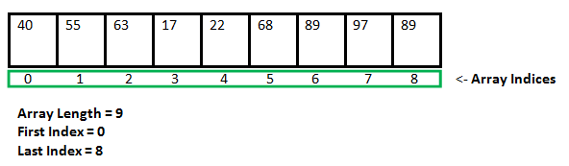
Arrays in JAVA

Slide 18
Arrays in JAVA
Advantage :
Code Optimization: It makes the code optimized, we can retrieve or sort the data easily.
Random access: We can get any data located at any index position.
Disadvantage :
Size Limit: We can store only fixed size of elements in the array. It doesn't grow its size at runtime.

Slide 19
Arrays in JAVA
Types of Array:
There are two types of array.
Single Dimensional Array
Multidimensional Array

Slide 20
Single Dimensional Arrays
Declaration Syntax:
type var-name[];
OR
type[] var-name;
Example:
int intArray[];
or
int[] intArray;

Slide 21
Single Dimensional Arrays
Instantiation of an Array in java:
arrayRefVar=new datatype[size];
Example:
int a[]=new int[5];
Declaration, Instantiation and Initialization
int a[]={1,2,3,4};

Slide 22
Multi Dimensional Arrays
Two Dimensional Array:
int[][] intArray = new int[10][20];
Three Dimensional Array:
int[][][] intArray = new int[10][20][10];

Slide 23
Multi Dimensional Arrays
class multiDimensional
{
public static void main(String args[])
{
// declaring and initializing 2D array
int arr[][] = { {2,7,9},{3,6,1},{7,4,2} };
// printing 2D array
for (int i=0; i< 3 ; i++)
{
for (int j=0; j < 3 ; j++)
System.out.print(arr[i][j] + " ");
System.out.println();
}
}
}

Slide 24
Multi Dimensional Arrays
Output
2 7 9
3 6 1
7 4 2

